Slide 1
John Cage Tribute
Sponsor: Dr. Leinecker
Group 12
Jacob Pfaffenbichler, Alper Aydin, Luke Blanchard, Yoan Hermida, Jason Tan

Slide 2
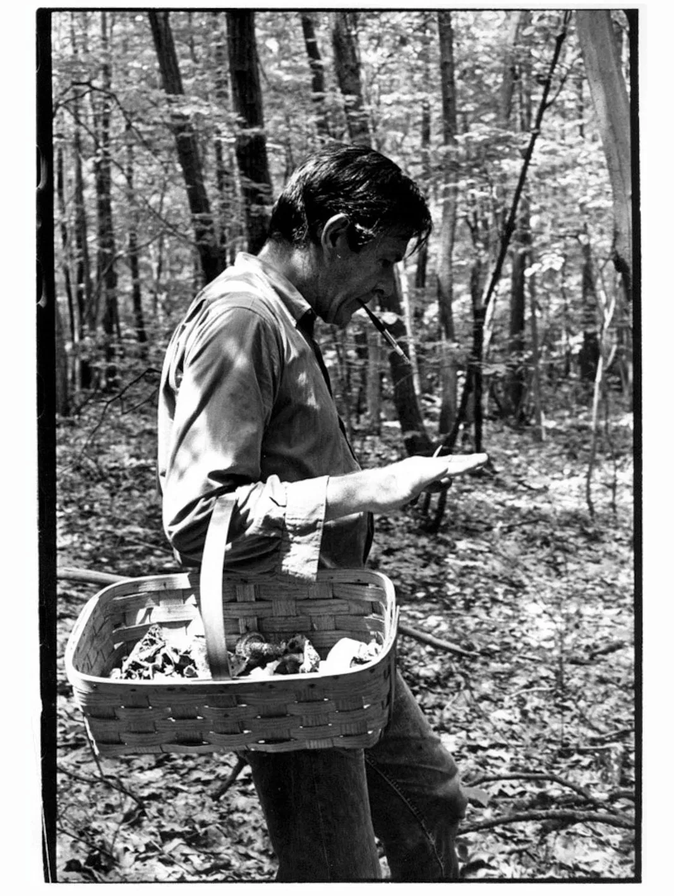
Who Was John Cage?
John Cage (September 5th 1912 - August 12th 1992) was an American composer.
Non-traditional compositions
Anything can be music
His famous piece 4’33”
“Whether I make them or not, there are always sounds to be heard and all of them are excellent."

Slide 3
John Cage Tribute
Honor John Cage
Create music when performers are far away from each other

Slide 4
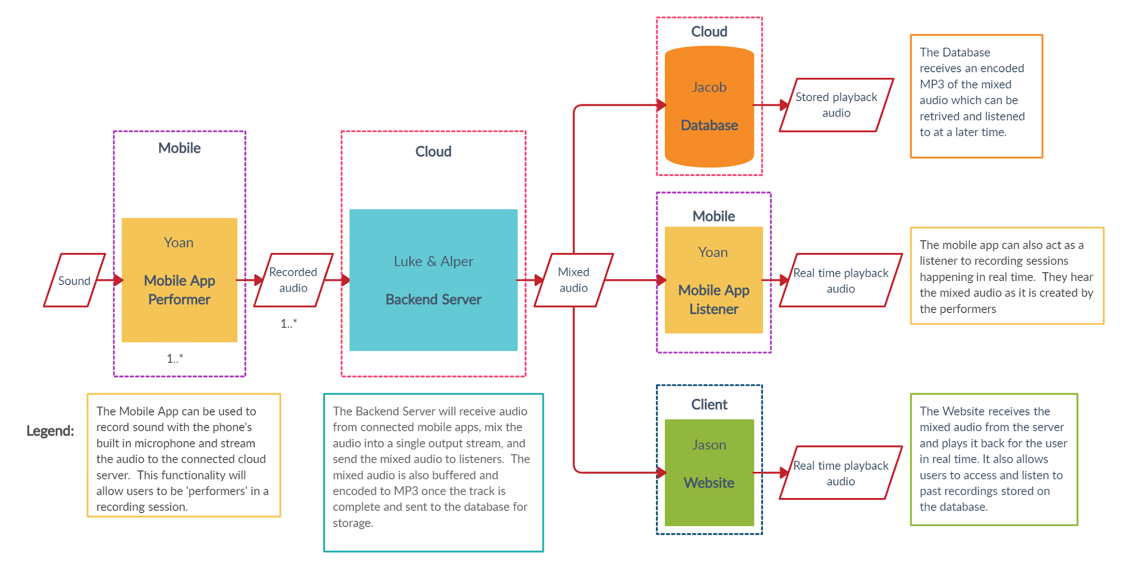
Technical Requirements
The John Cage Tribute consists of four key elements:
Mobile Application - Yoan
Server/Audio Processing - Alper and Luke
Database/PM - Jacob
Web Application - Jason

Slide 5

Mobile Application
Built in: Dart + Flutter (Swift+Kotlin for audio plugins)
Anticipated Launches:
Google Play Store
Apple App Store
Supported Versions:
Android 28+ (Audio plugins require 28+)
iOS 8+ (Audio plugins, XCode v12.1 enforces iOS 8+)

Slide 6
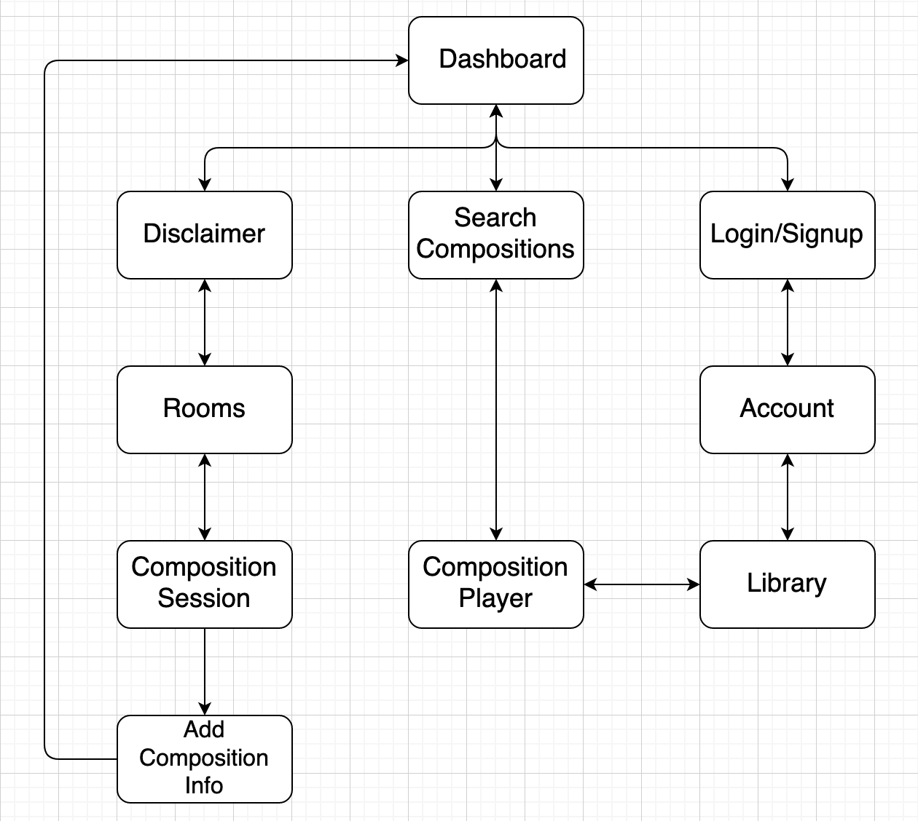

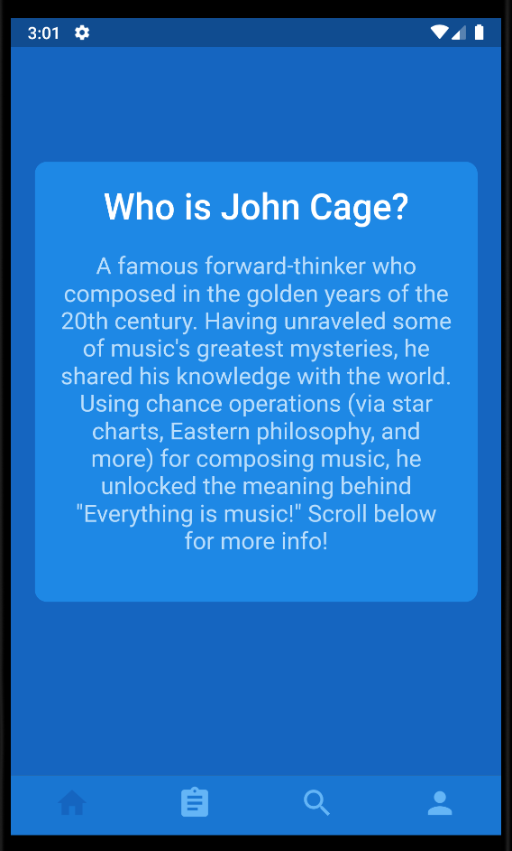
Mobile: UI and Nav.
Think Apple
Minimal
But blue theme

Slide 7
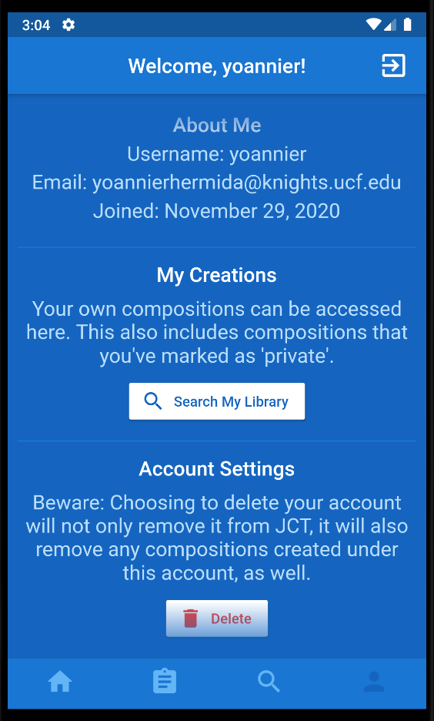
Mobile: Authentication
Login/Signup that leads into an Account screen
JWT generated upon authentication
Expires in approx. 10 days
Guests have use restrictions, including:
Creating sessions
Being credited in composition performances
Viewing compositions via Library

Slide 8
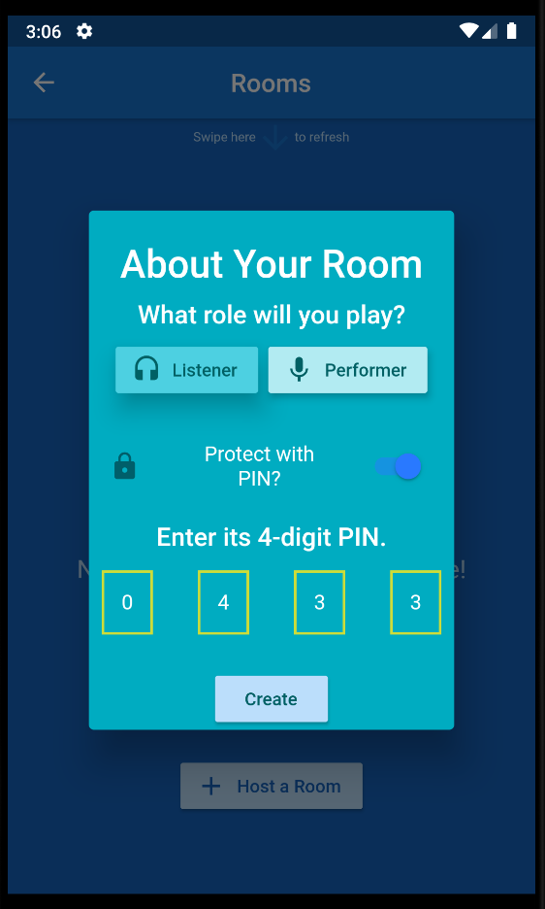
Mobile: Room Session Setup
Available and new sessions update quickly via sockets
Users are divided into Performers and Listeners:
Performer: Provides mic input for audio mixing
(must accept mic permission)
Listener: Listens to mixed audio in real time
Max 4-8 Performers per room, max 3 Listeners
(server intensity-conscious room capacities)
4-digit PIN can be made to protect room entry
Host is the designated composer (composition owner)

Slide 9
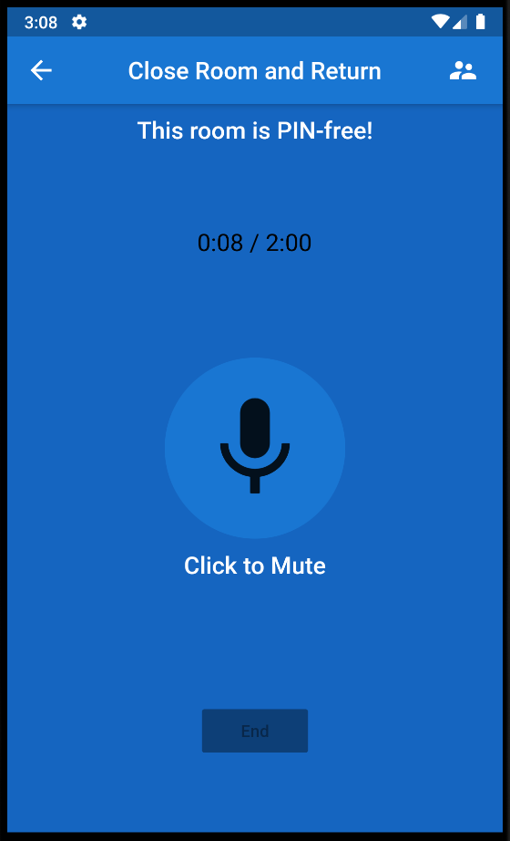
Mobile: Session Initiation
Composer can end their session between 2-10 min.
Session begins once:
Max performers reached
Composer clicks Start button
Upon completion:
Non-composers are greeted with a success message
The composer is led to the Comp. Info Screen
This is where they can provide their composition:
A title, description, tags, and private/public setting

Slide 10
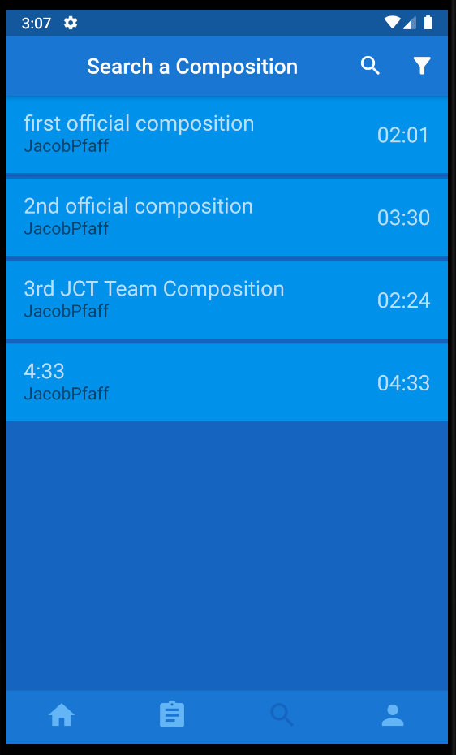
Mobile: Search and Play Compositions
Search Screen and Library Screen can search by:
Composer name
Tags (Compositions support up to 3)
And Performer names (excluding guests)
Can edit/delete composition on Library
Audio Player brings user to a new screen, allowing for:
Viewing composition information
Playing its audio

Slide 11
Socket Behavior in Server
Implemented in Socket.IO using JavaScript
Improves real-time audio transfer through use of socket messaging (via ‘emit’ and ‘on’ keywords)
HashMaps are used to map rooms to its members and info about them
Upon successful completion of a session or if the room host disconnects, the room is removed from the map and its members are alerted of the completion/failure

Slide 12



Server
Hosting Process Management Reverse Proxy

Slide 13
Audio Processing in the Server
Receive audio from 4 - 8 performers
Mix the audio from performers together
Listeners hear the mixed audio in close to real time
Audio from the completed recording session saved to database

Slide 14
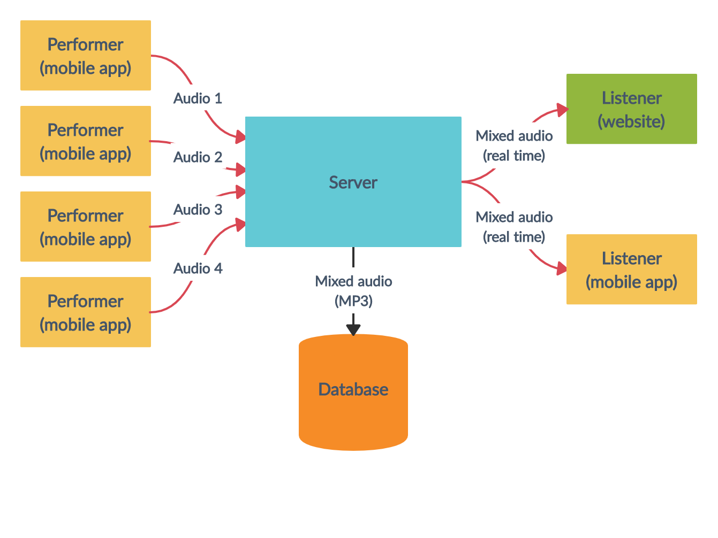
Audio Processing in the Server

Slide 15
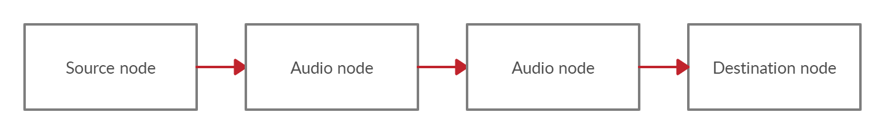
Web Audio API
Web-audio-js - implementation for Node.js
Allows modular routing of audio through audio nodes
Multiple audio nodes can be linked together to form an audio graph

Slide 16
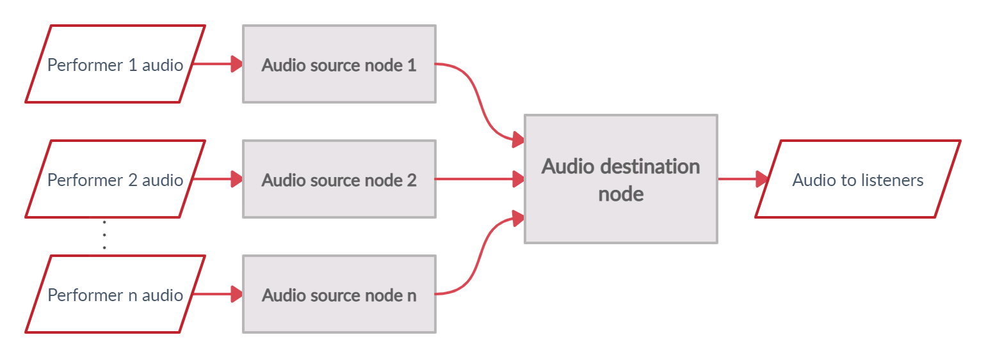
Audio Graph for a Recording Session
Audio source nodes - 1 per performer with 1 input and 1 output
Audio destination node - 1 per room with 1 input per performer and 1 output

Slide 17
Load Distribution
Audio Processing takes a lot of processing power
We don’t want to block the main event loop by processing audio in the main thread
Node.js Child Processes allows us to move this computation-intensive task to its own thread

Slide 18
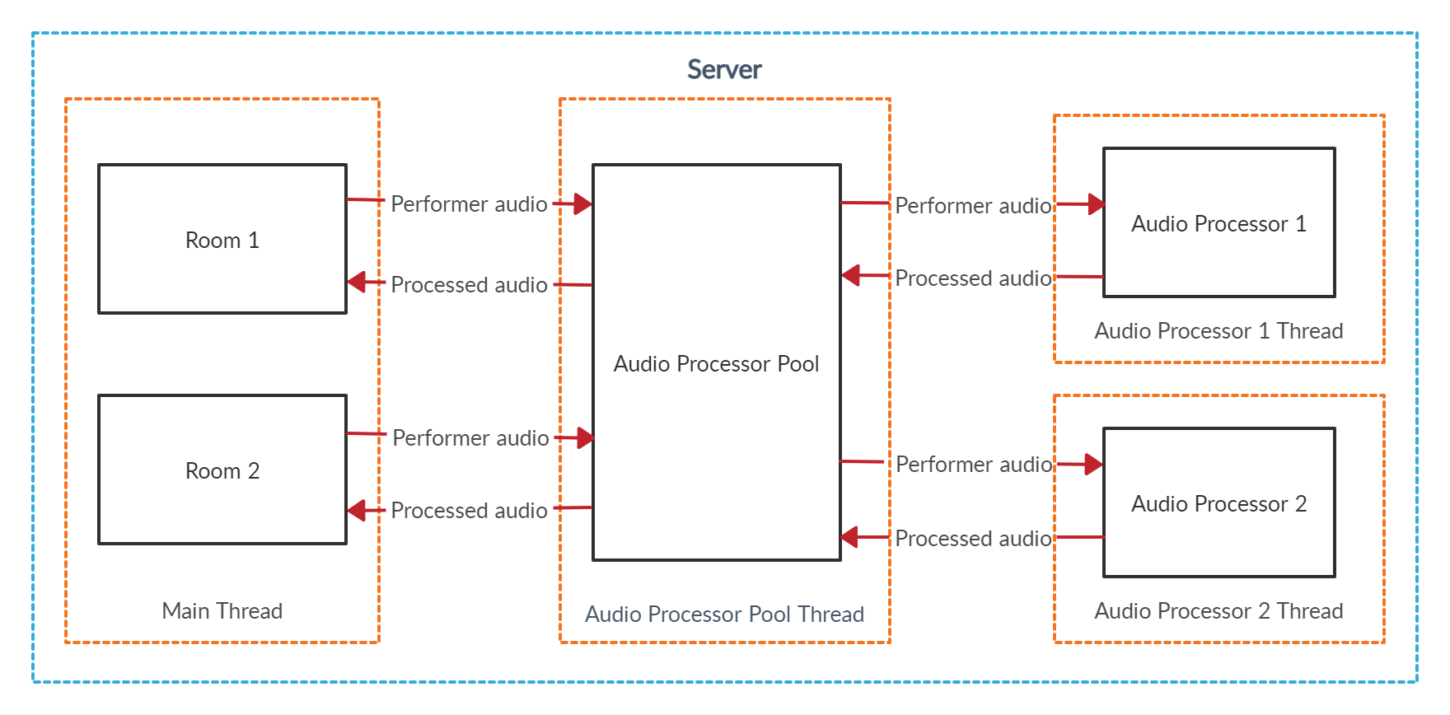
Multithreading and Scalability

Slide 19
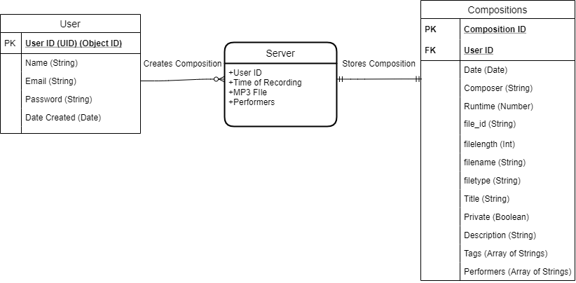
Database
MERN Stack (Mongo Db, Express.js, React, Node.JS)

Slide 20
User Accounts
Confirm Password
Database checks if email is unique
Bcrypt is used to encrypt passwords.
Signup/login give a JSON Web Token (JWT)

Slide 21
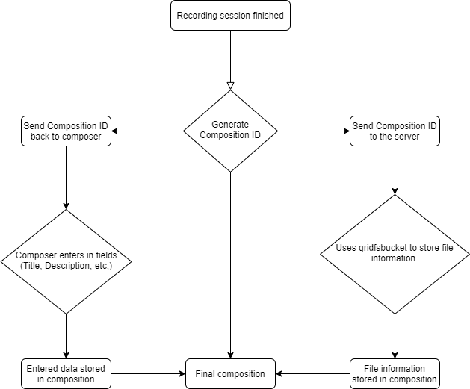
Compositions
GridFS is used to store files on the database

Slide 22
Compositions (Cont.)
Change information after composition is stored
Default values for title and description, private defaults to false
Checks to make sure title and description aren’t too long
Deleting compositions
Deleting User Account also deletes all compositions

Slide 23

Front End
React JS
React-Redux
State management: User information
Minimalistic design, focusing on functionality
Managing user accounts and compositions
Search and listen to recorded compositions
Listening to live recordings in real-time

Slide 24
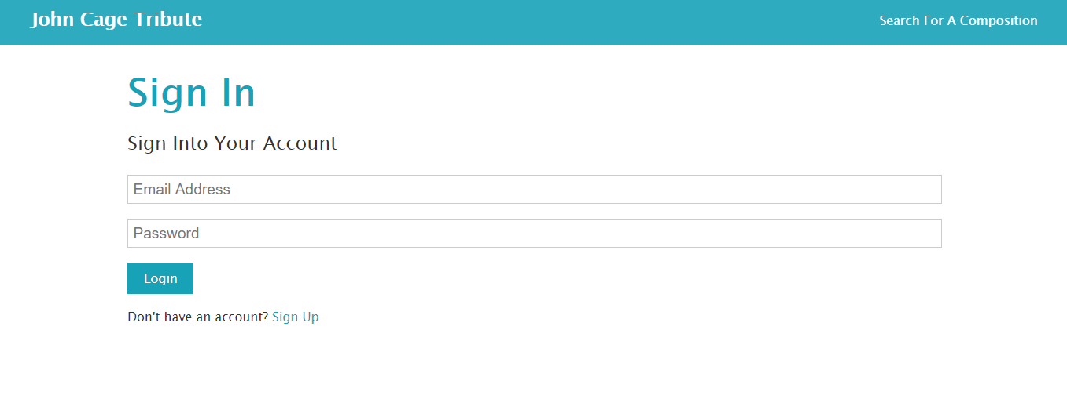
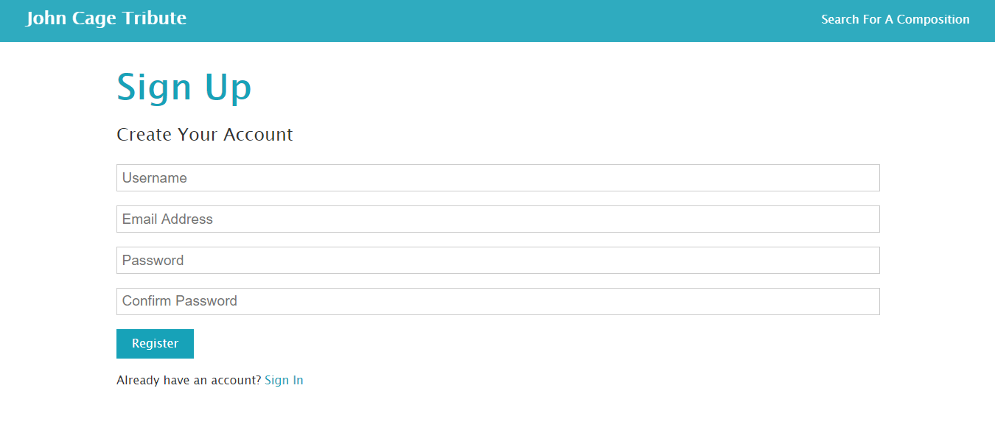
Login / Register

Slide 25
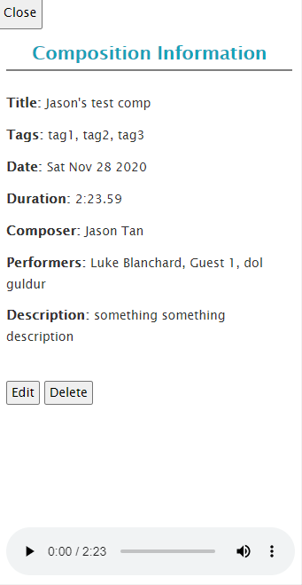
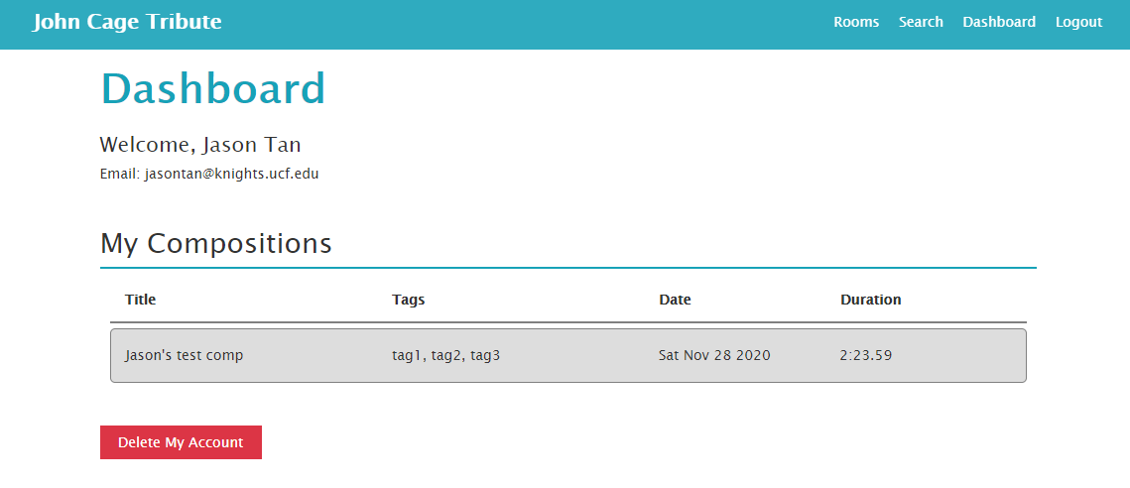
Dashboard

Slide 26
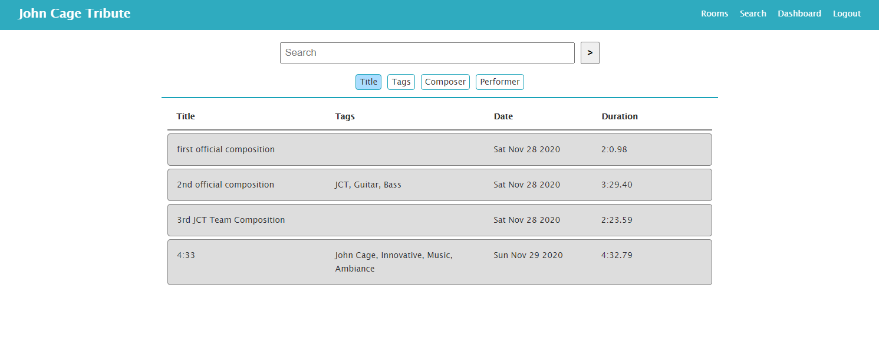
Search

Slide 27
Indeterminate Audio Processing Algorithm
Indeterminate Audio Processing Algorithm needed.
Why Indeterminacy?
What is music? Expected or Unexpected? What if something was Unexpected?
Some accepted as music while others are not?
Should we limit the spectrum of sound?

Slide 28
John Cage Wisdom
Reality may be uncertain
Expectation may influence perception
Every sound can be music and sound is not the only thing happening.
Two performances ever the same? What is the moment?
Can we attain pure silence?

Slide 29
Scope of Work
The works and philosophy of john cage explore the deep philosophical realms of the indeterminacies in sound, music, and existence.
Greatly influenced the genre of electroacoustic music and used instruments and computer technology in unorthodox ways to generate unusual sounds, timbres, and patterns that were "chance-based.

Slide 30
Unconventional Methods of Composition
Used the hexagrams within an ancient chinese classical text called the Yi Jing to land on a chapter within the book and get answers.
Divination to capture the moment in composition.
The Yi Jing provided the Indeterminacies he needed in his work.
Traditional composers rebuked his methods, sometimes booing or hissing at his performances. He implied that these were also phenomena happening that were a part of the composition. That if they are modern men, in reality they are booing at the logical conclusion of their own position as it strikes their ears in music. The truth about the universe may be a chance situation.

Slide 31
How to Establish Indeterminacy (Sieve of Arrays)
A ->
-> B
Sometimes A == B (the input may come out the exact same, unmodified)!
[Each Array represents the spectrum of a sound variable]
Variables:
Duration
Pitch
Volume
Timbre
Envelope

Slide 32
Yi Jing Implementation
Example of Chapter reading we land on:
10 - Ten
Lü / Worrying the Tiger
Heaven shines down on the Marsh which reflects it back imperfectly:
Though the Superior Man carefully discriminates between high and low, and acts in accord with the flow of the Tao, there are still situations where a risk must be taken.
You tread upon the tail of the tiger.
Not perceiving you as a threat, the startled tiger does not bite.
Success.
You have reached a perilous point in your journey.
This is a real gamble -- not a maneuver, not a calculated risk.
The outcome is uncertain.
If it goes as you hope, you will gain -- but if it turns against you it will cause serious injury, at least to your plans.
The best tack is extreme caution and a healthy respect for the danger involved.

Slide 33
Yi Jing Implementation
Use each chapter's interpretation to limit the intervals of the indices that we can land on to produce a particular sound
Rejuvenation may mean a peaceful more relaxed composition
Could limit different interpretations of the same chapter.
Stretch goal: Better implementation of Yi Jing

Slide 34
Randomization Done During Performance by Performer?
Should the application randomize the sounds?
Randomization being done by performer during a performance may allow more customization and control over the randomization.
Application adding in effects randomly may provide cool sounding variations that may help a performer who is not as well equipped.

Slide 35
Future Plans
Cache searches and provide composition recommendations
Allow users to manually set parameters for audio effects
Better implementation of the Yi Jing
Get the UCF School of Music involved in the project

Slide 36
Budget
DigitalOcean server ($20/month)
Play Store ($25)
IOS Store ($99/year)

Slide 37
Conclusion

